Slide 1
Sql answer

Slide 2
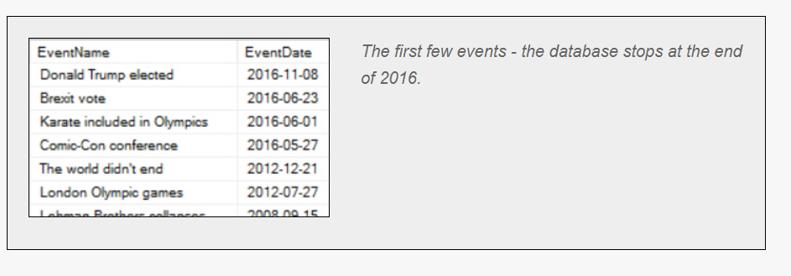
Simple queries Question1- Order by
Create a query to list out the following columns from the tblEvent table, with the most recent first (for which you'll need to use an ORDER BY clause):
The event name
The event date

Slide 3
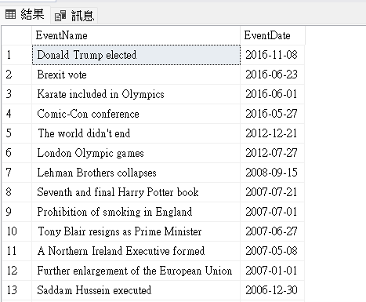
Answer1.
SELECT e.EventName,e.EventDate
FROM WorldEvents.dbo.tblEvent as e
ORDER BY e.EventDate DESC
ORDER BY :根據某個table來做排序
DESC:由大到小
ASC:由小到大(預設
參考資料:https://www.w3schools.com/sql/sql_orderby.asp

Slide 4
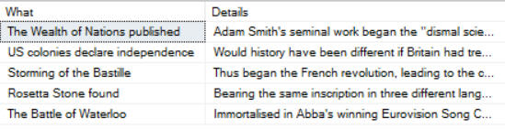
Simple queries Question2- Aliases
Write a query to show the first 5 events (in date order) from the tblEvent table:
There are a few things to notice about this:
You should give the columns aliases (What and Details in this case);
Use SELECT TOP 5 to limit the results to 5 rows;
Even though you're sorting by the event date, it doesn't have to be included in your results.

Slide 5
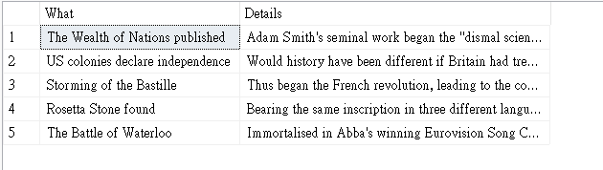
Answer2.
SELECT TOP 5 e.EventName as 'What',e.EventDetails as 'Details'
FROM WorldEvents.dbo.tblEvent as e
ORDER BY e.EventDate ASC
參考資料:https://www.w3schools.com/sql/sql_alias.asp

Slide 6
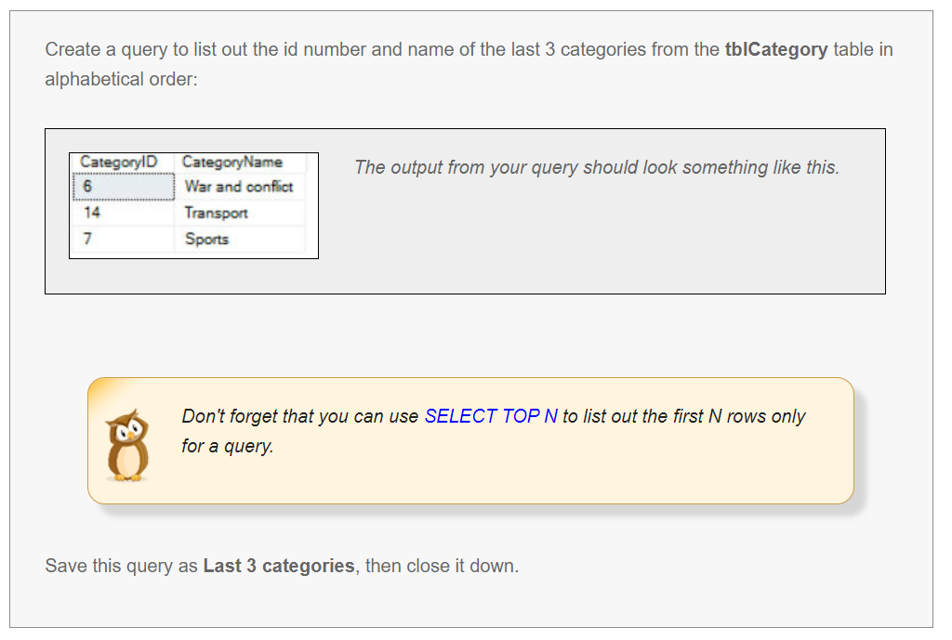
Simple queries Question3

Slide 7
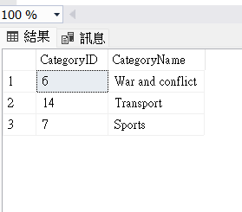
Answer3.
SELECT TOP (3) [CategoryID],[CategoryName]
FROM [WorldEvents].[dbo].[tblCategory]
Order By CategoryName Desc

Slide 8
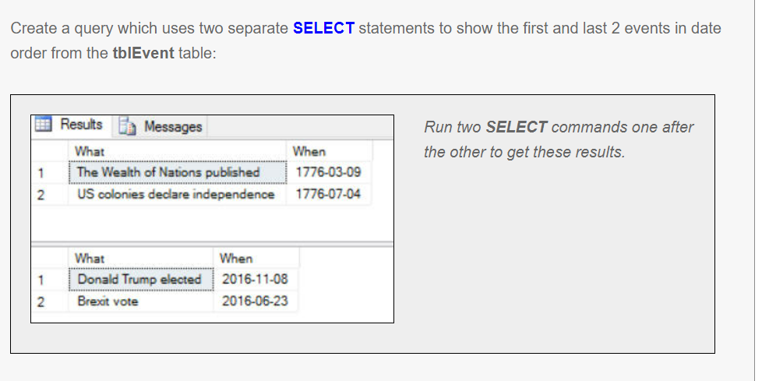
Simple queries Question4

Slide 9
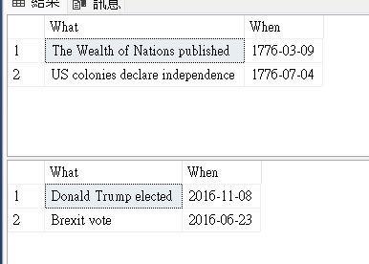
Answer4.
SELECT TOP (2) [EventName] as 'What',[EventDate] as 'When'
FROM [WorldEvents].[dbo].[tblEvent]
ORDER BY [EventDate] ASC
SELECT TOP (2) [EventName] as 'What',[EventDate] as 'When'
FROM [WorldEvents].[dbo].[tblEvent]
ORDER BY [EventDate] DESC

Slide 10
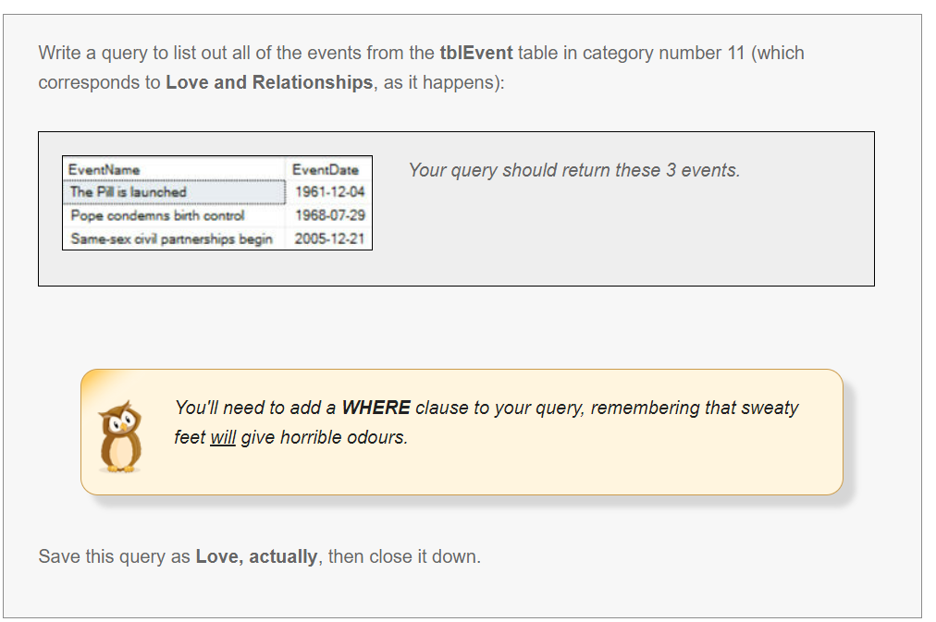
Setting criteria using WHERE Q1 Question1

Slide 11
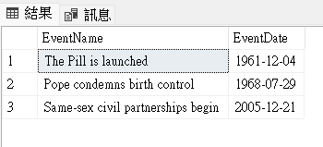
Answer1.
SELECT [EventName],[EventDate]
FROM [WorldEvents].[dbo].[tblEvent] as e
WHERE e.[CategoryID] ='11'

Slide 12
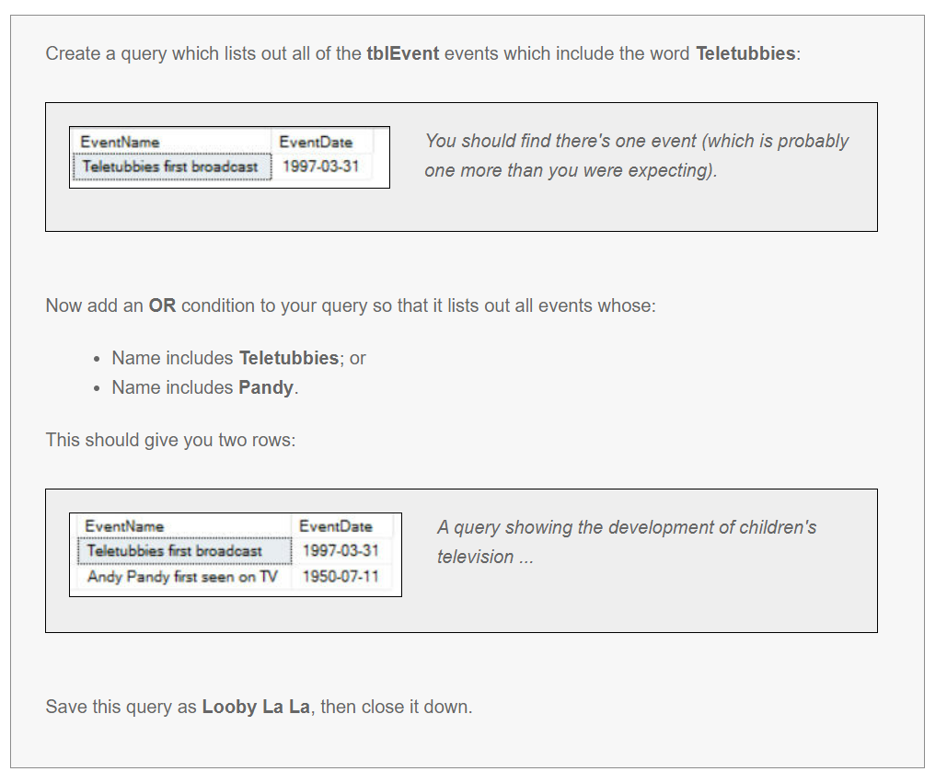
Setting criteria using WHERE Q2

Slide 13
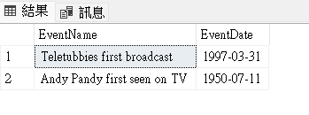
Answer2.
SELECT [EventName],[EventDate]
FROM [WorldEvents].[dbo].[tblEvent] as e
WHERE e.[EventName] like '%Teletubbies%'
OR e.[EventName] like '%Pandy%'
參考資料:https://stackoverflow.com/questions/14290857/sql-select-where-field-contains-words

Slide 14
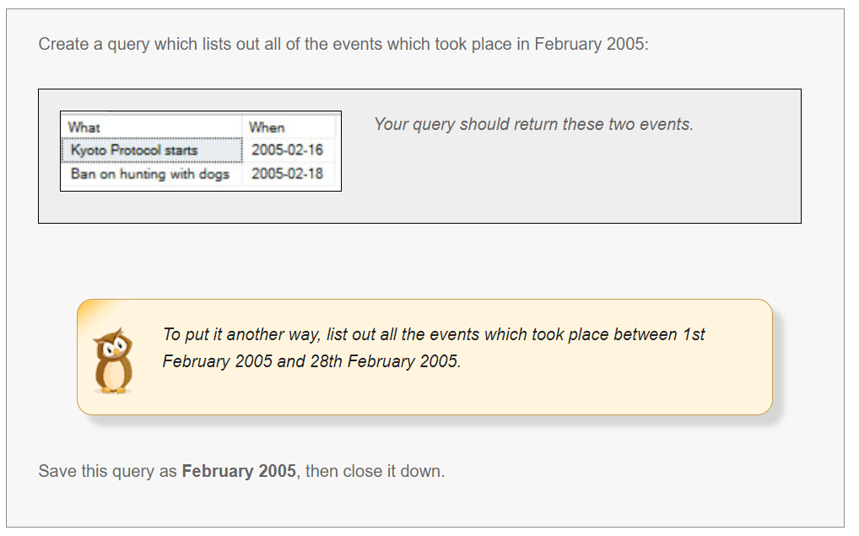
Setting criteria using WHERE Q3

Slide 15
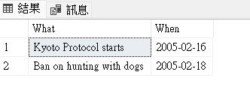
Answer3.
SELECT [EventName] as 'What',[EventDate] as 'When'
FROM [WorldEvents].[dbo].[tblEvent] as e
WHERE e.[EventDate] like '2005-02%'
參考資料:https://stackoverflow.com/questions/14290857/sql-select-where-field-contains-words

Slide 16
Setting criteria using WHERE Q4

Slide 17
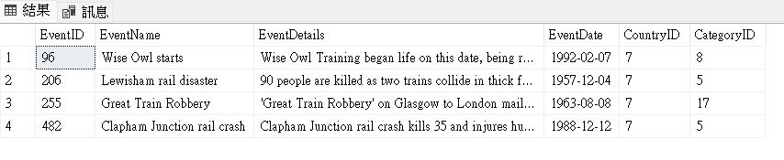
Answer4-1.
SELECT *
FROM [WorldEvents].[dbo].[tblEvent] as e
WHERE e.[CategoryID] <>14
AND e.EventDetails like '%Train%'
參考資料:https://www.w3schools.com/sql/sql_operators.asp

Slide 18
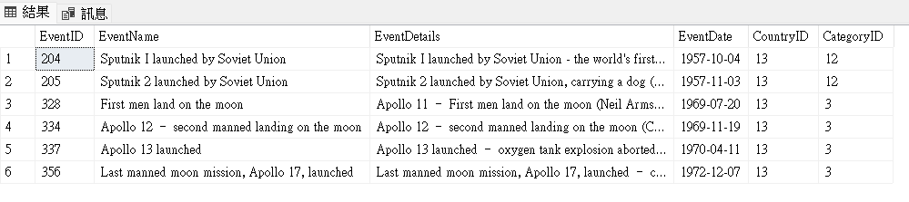
Answer4-2.
SELECT *
FROM [WorldEvents].[dbo].[tblEvent] as e
WHERE e.[CountryID] = 13
AND e.EventDetails not like '%Space%'
AND e.EventName not like '%Space%'
參考資料:https://www.w3schools.com/sql/sql_operators.asp

Slide 19
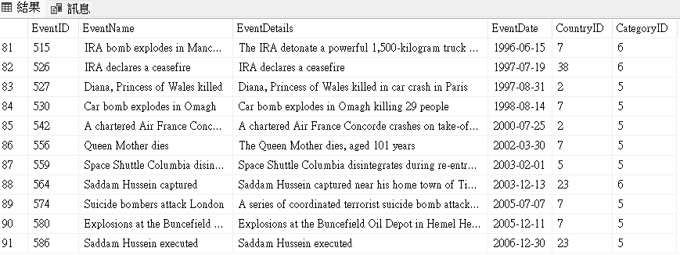
Answer4-3.
SELECT *
FROM [WorldEvents].[dbo].[tblEvent] as e
WHERE e.[CategoryID] in (5,6)
AND e.EventDetails not like '%War%'
AND e.EventDetails not like '%Death%'
參考資料:https://www.w3schools.com/sql/sql_operators.asp

Slide 20
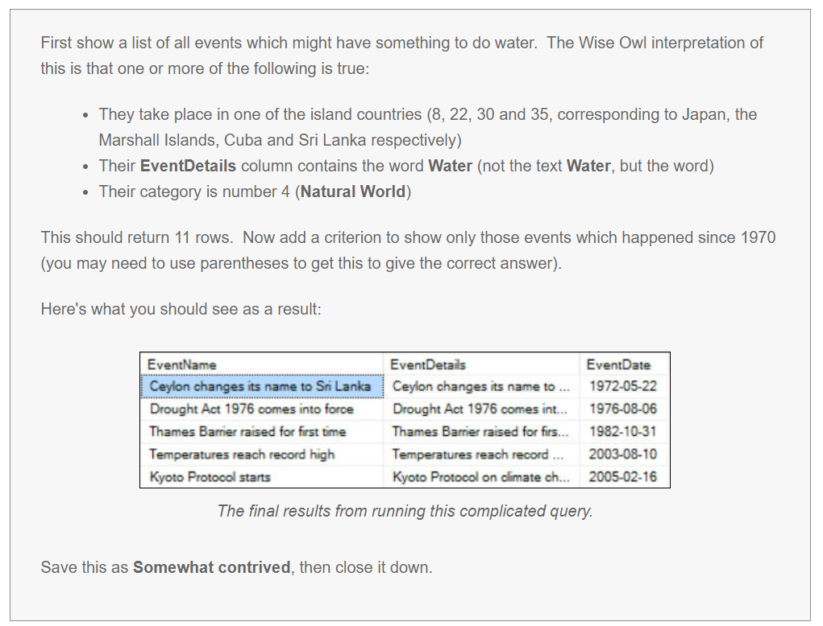
Setting criteria using WHERE Q5

Slide 21
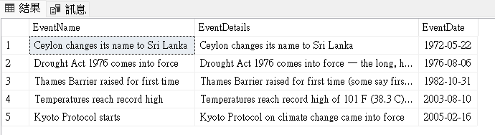
Answer5.
SELECT [EventName],[EventDetails],[EventDate]
FROM [WorldEvents].[dbo].[tblEvent] as e
WHERE (e.CategoryID = 4 or e.EventDetails like '% Water %' or e.CountryID in (8,22,30,35)) AND DATEPART(YEAR, EventDate) > 1970
參考資料:https://www.w3schools.com/sql/func_sqlserver_datepart.asp

Slide 22
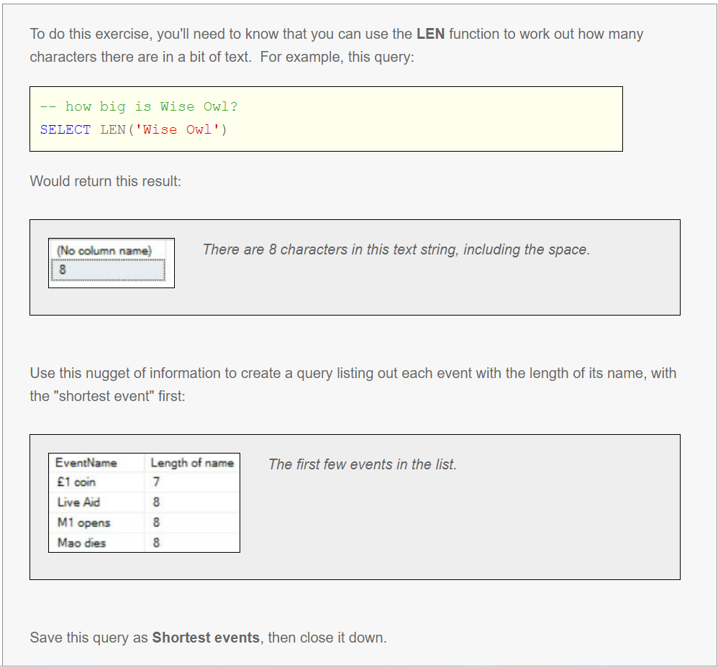
Calculations Q1

Slide 23
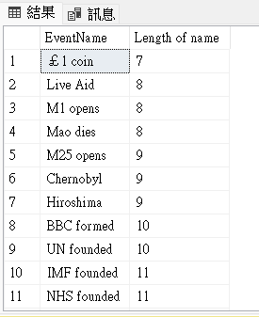
Answer1.
SELECT [EventName] , LEN(EventName) as 'Length of name'
FROM [WorldEvents].[dbo].[tblEvent] as e
ORDER BY LEN(EventName) ASC
參考資料:https://www.w3schools.com/sql/func_sqlserver_len.asp

Slide 24
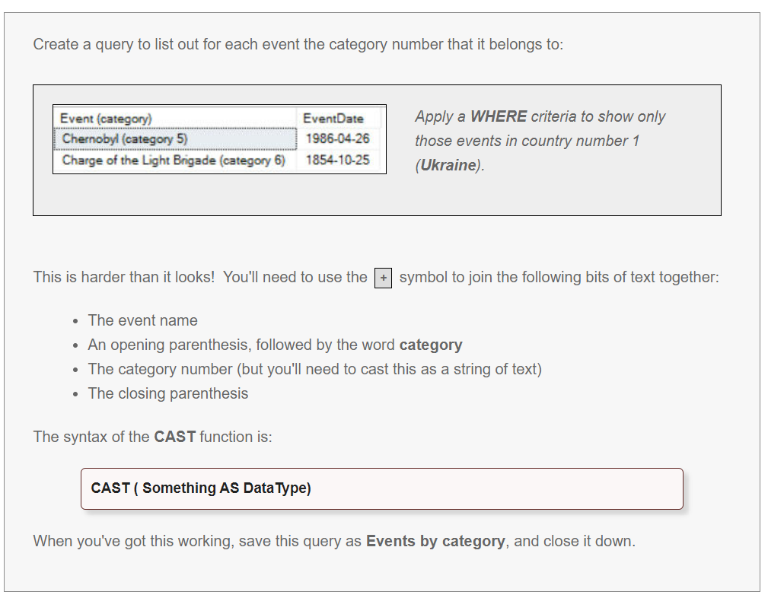
Calculations Q2

Slide 25
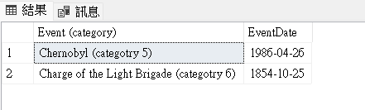
Answer2.
SELECT [EventName] +' (categotry ' + CAST(CategoryID as nvarchar(10)) +')' as 'Event (category)',[EventDate]
FROM [WorldEvents].[dbo].[tblEvent]
WHERE [CountryID]=1
參考資料:https://www.w3schools.com/sql/func_sqlserver_concat_with_plus.asp
參考資料:https://www.w3schools.com/sql/func_sqlserver_cast.asp

Slide 26
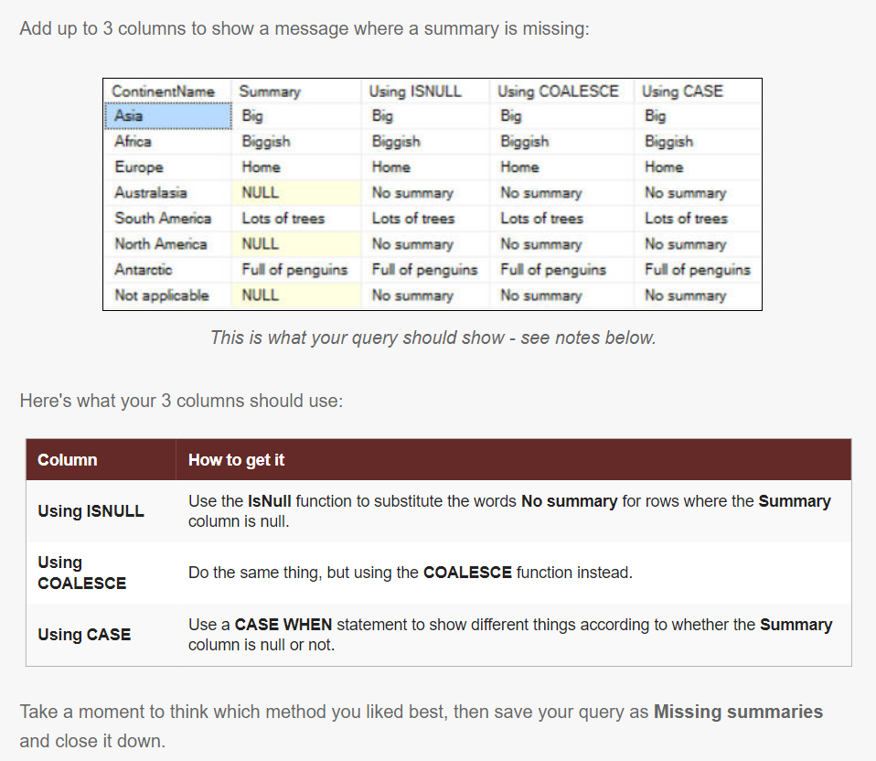
Calculations Q3

Slide 27
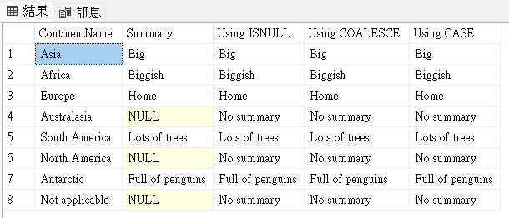
Answer3.
SELECT [ContinentName]
,[Summary],
--using isnull
ISNULL(t.Summary,'No summary') AS 'Using ISNULL',
--using coalesce
COALESCE(t.Summary,'No summary') AS 'Using COALESCE',
--using case
CASE
WHEN t.Summary is null THEN 'No summary'
ELSE t.Summary
END AS 'Using CASE'
FROM [WorldEvents].[dbo].[tblContinent] as t
參考資料:https://dotblogs.com.tw/SteveLiu/2019/05/21/174116
參考資料:https://www.w3schools.com/sql/sql_case.asp

Slide 28
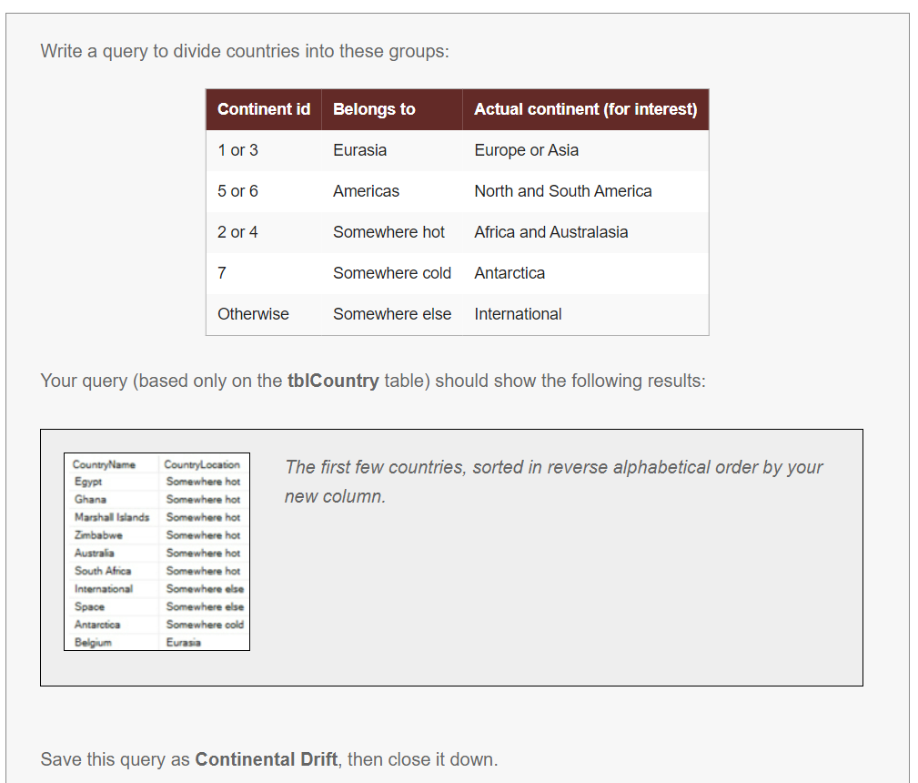
Calculations Q4

Slide 29
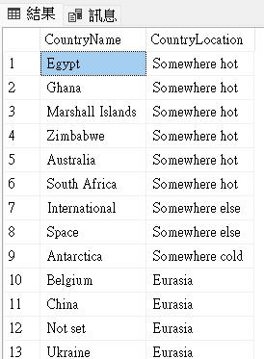
Answer4.
SELECT t.[CountryName],
CASE
WHEN t.ContinentID in(1,3) THEN 'Eurasia'
WHEN t.ContinentID in(5,6) THEN 'Americas'
WHEN t.ContinentID in(2,4) THEN 'Somewhere hot'
WHEN t.ContinentID =7 THEN 'Somewhere cold'
else 'Somewhere else'
END AS 'CountryLocation'
FROM [WorldEvents].[dbo].[tblCountry] as t
ORDER BY CountryLocation DESC
參考資料:https://www.w3schools.com/sql/sql_case.asp

Slide 30
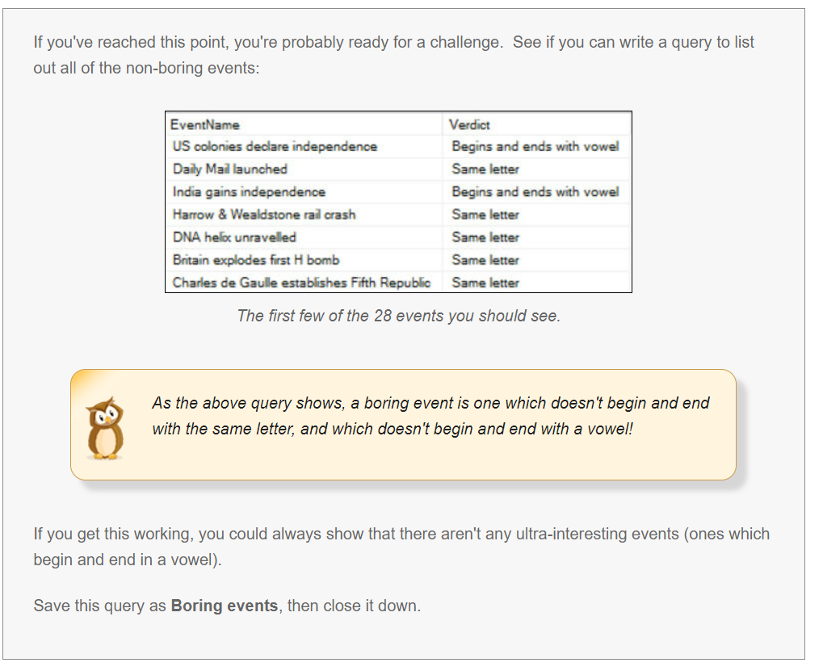
Calculations Q5

Slide 31
Answer5.
SELECT e.[EventName],
CASE
WHEN CHARINDEX(left(e.EventName,1),'aeiou',1) >0 AND left(e.EventName,1) = right(e.EventName,1) THEN 'Same vowel'
WHEN left(e.EventName,1) = right(e.EventName,1) THEN 'Same letter'
WHEN CHARINDEX(left(e.EventName,1),'aeiou',1) >0 AND CHARINDEX(right(e.EventName,1),'aeiou',1) >0 THEN 'Begins and ends with vowel'
ELSE 'Boring event!'
END AS 'Verdict'
FROM [WorldEvents].[dbo].[tblEvent] AS e
參考資料:https://vimsky.com/zh-tw/examples/usage/sql-server-charindex-function-01.html

Slide 32
Answer5.
WHERE
CASE
WHEN left(e.EventName,1) = right(e.EventName,1) THEN 'Same letter'
WHEN CHARINDEX(left(e.EventName,1),'aeiou',1) >0 AND CHARINDEX(right(e.EventName,1),'aeiou',1) >0 THEN 'Begins and ends with vowel'
ELSE 'Boring event!'
END <> 'Boring event!'
ORDER BY e.EventDate asc
參考資料:https://vimsky.com/zh-tw/examples/usage/sql-server-charindex-function-01.html

Slide 33
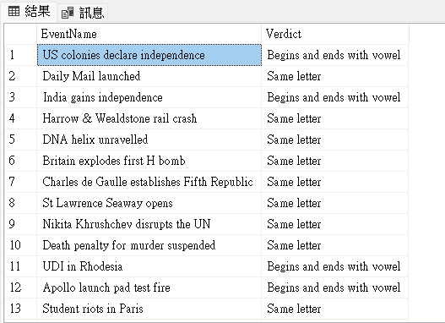
Answer5.
參考資料:https://vimsky.com/zh-tw/examples/usage/sql-server-charindex-function-01.html

Slide 34
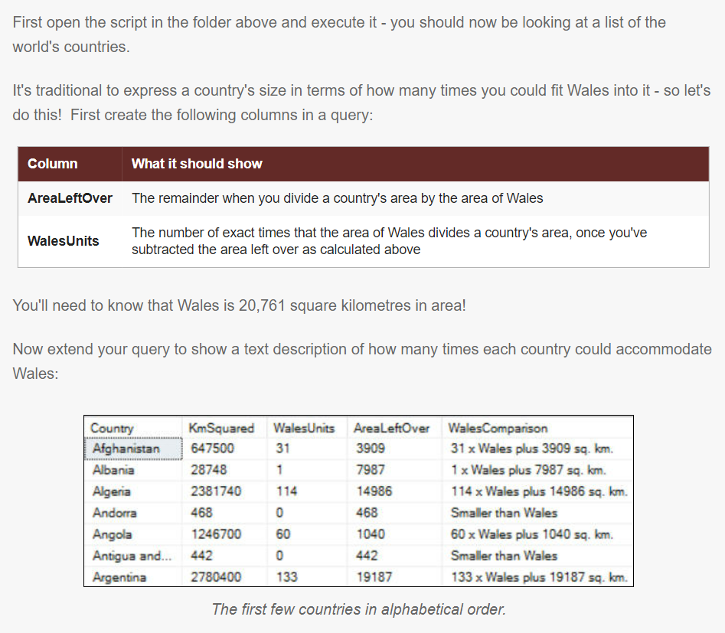
Calculations Q6

Slide 35
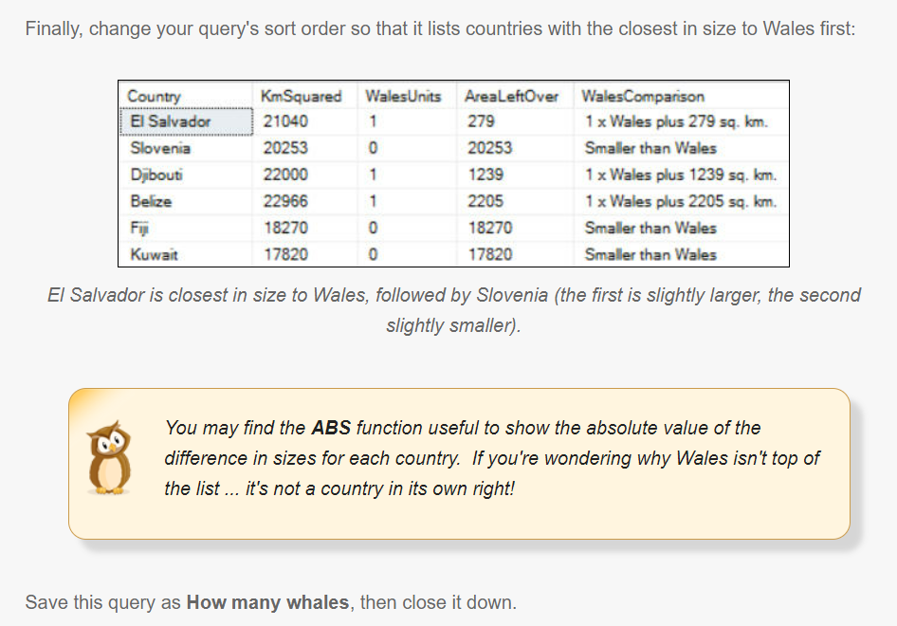
Calculations Q6

Slide 36
Answer6.
SELECT c.Country,
c.KmSquared,
(c.KmSquared-c.KmSquared % 20761)/20761 AS 'WalesUnits',
c.KmSquared % 20761 AS 'AreaLeftOver',
CASE
WHEN c.KmSquared < 20761 THEN 'Smaller than Wales'
ELSE CAST((c.KmSquared-c.KmSquared % 20761)/20761 AS varchar(100)) + 'x Wales plus '
+CAST(c.KmSquared % 20761 AS varchar(100))
+'sq. km. '
END AS WalesComparison
FROM [WorldEvents].[dbo].[CountriesByArea] as c
ORDER BY ABS(20761-c.KmSquared) ASC
參考資料:https://www.w3schools.com/sql/sql_case.asp

Slide 37
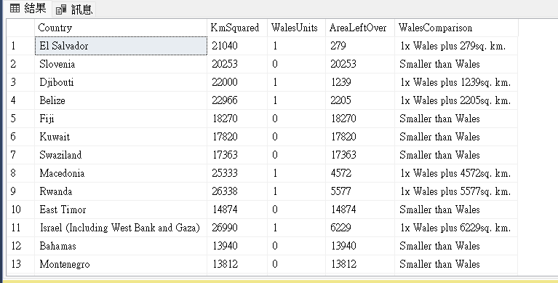
Answer6.
參考資料:https://www.w3schools.com/sql/sql_case.asp

Slide 38
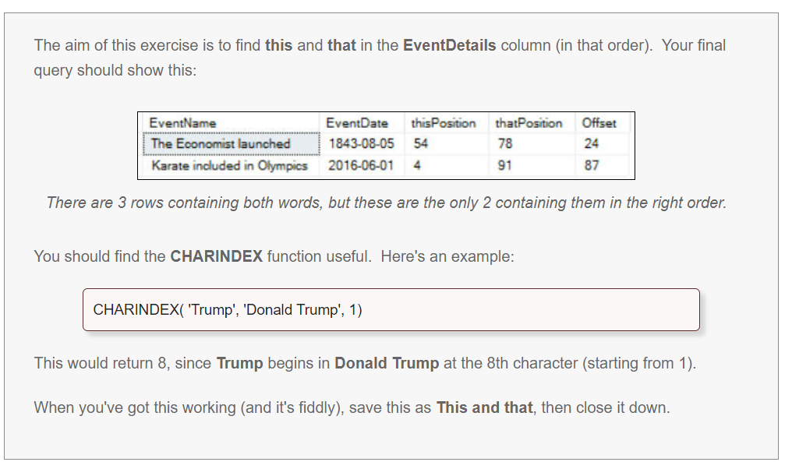
Calculations Q7

Slide 39
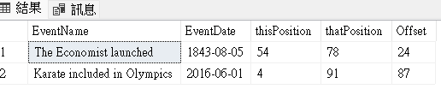
Answer7.
SELECT e.[EventName], e.[EventDate],
CHARINDEX('this',e.EventDetails) as 'thisPosition',
CHARINDEX('that',e.EventDetails) as 'thatPosition',
CHARINDEX('that',e.EventDetails)- CHARINDEX('this',e.EventDetails) as 'Offset'
FROM [WorldEvents].[dbo].[tblEvent] as e
WHERE CHARINDEX('this',e.EventDetails)>0
AND CHARINDEX('that',e.EventDetails)>0
AND CHARINDEX('that',e.EventDetails) - CHARINDEX('this',e.EventDetails)>0
參考資料: https://vimsky.com/zh-tw/examples/usage/sql-server-charindex-function-01.html

Slide 40
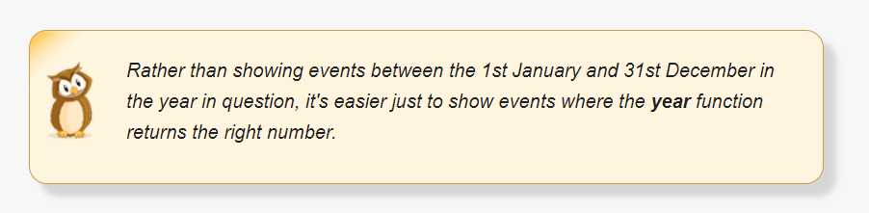
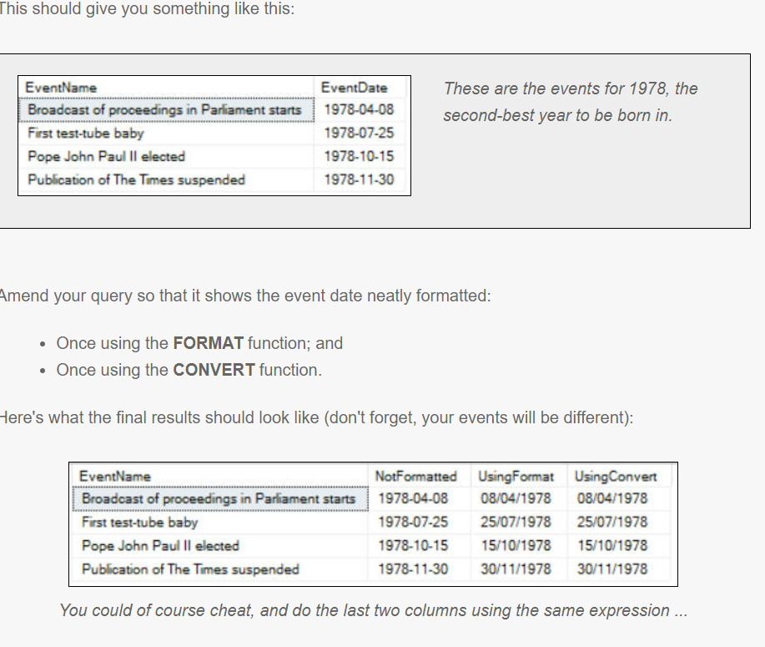
Calculations using dates Q1

Slide 41
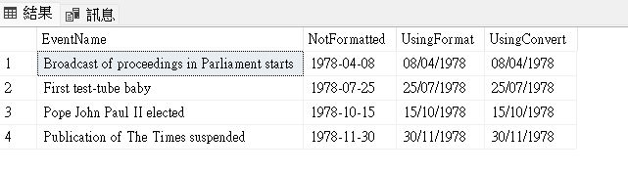
Answer1.
SELECT e.[EventName],
e.[EventDate] as 'NotFormatted',
FORMAT(e.EventDate,'dd/MM/yyyy') AS 'UsingFormat',
CONVERT (varchar(10),e.EventDate,103) AS 'UsingConvert'
FROM [WorldEvents].[dbo].[tblEvent] as e
WHERE YEAR(e.EventDate)=1978
ORDER BY e.EventDate ASC
參考資料:https://www.mssqltips.com/sqlservertip/2655/format-sql-server-dates-with-format-function/
參考資料:https://networking.ringofsaturn.com/SQL/howtoformatdatetime.php

Slide 42
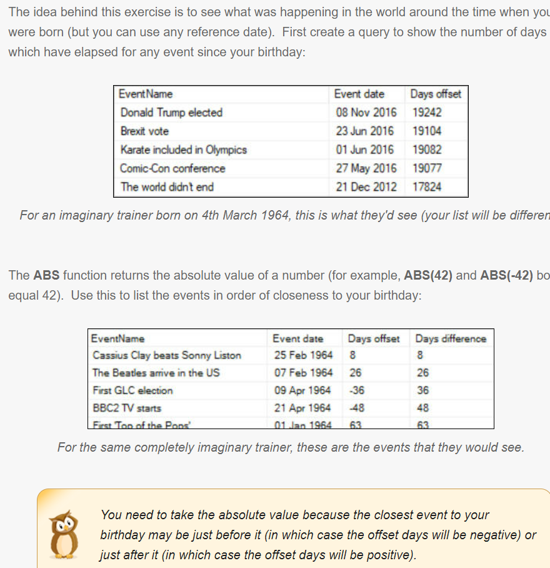
Calculations using dates Q2

Slide 43
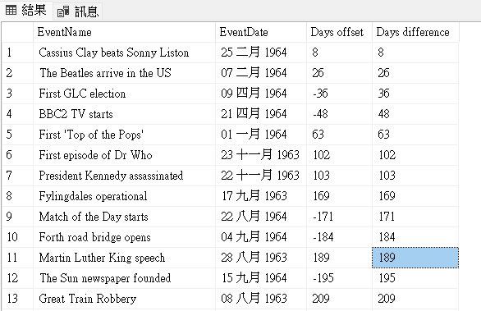
Answer2.
SELECT e.[EventName],
FORMAT(e.[EventDate],'dd MMM yyyy') as 'EventDate',
DATEDIFF(DAY,e.EventDate,'19640304') as 'Days offset',
ABS(DATEDIFF(DAY,e.EventDate,'19640304')) as 'Days difference'
FROM [WorldEvents].[dbo].[tblEvent] as e
ORDER BY 'Days difference' asc
參考資料:https://www.fooish.com/sql/sql-server-datediff-function.html

Slide 44
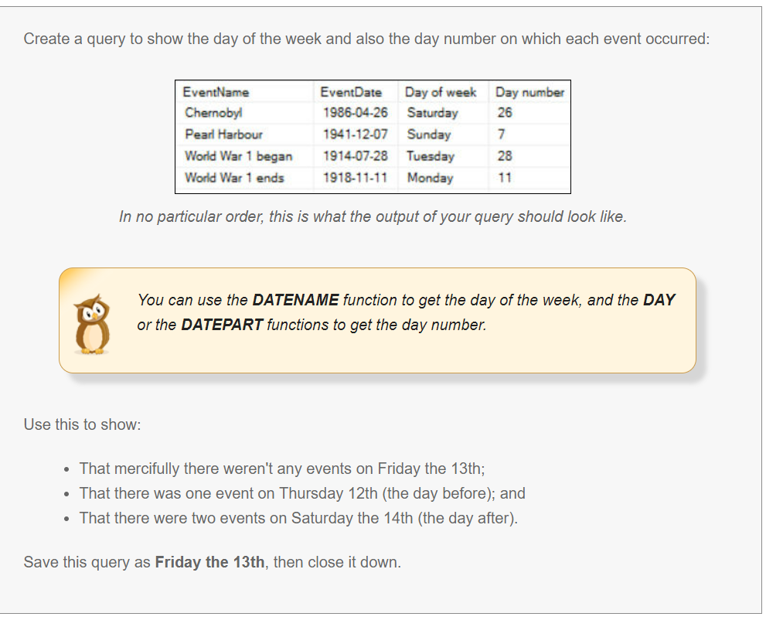
Calculations using dates Q3

Slide 45
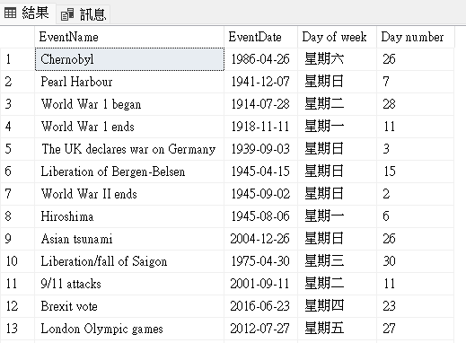
Answer3.
SELECT e.[EventName],
e.[EventDate],
DATENAME(WEEKDAY,e.EventDate) AS 'Day of week',
DATEPART(DAY,e.EventDate) AS 'Day number'
FROM [WorldEvents].[dbo].[tblEvent] as e
參考資料:https://www.w3schools.com/sql/func_sqlserver_datename.asp
參考資料:https://www.w3schools.com/sql/func_sqlserver_datepart.asp

Slide 46
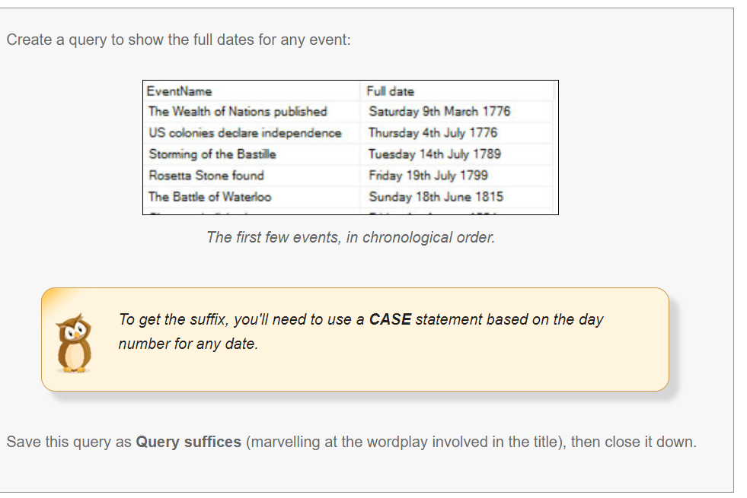
Calculations using dates Q4

Slide 47
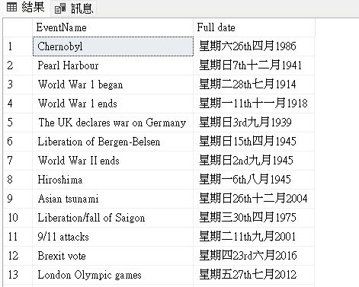
Answer4.
SELECT e.[EventName],
DATENAME(WEEKDAY,e.EventDate) +
DATENAME(DAY,e.EventDate) +
CASE
WHEN DATEPART(DAY,e.EventDate) IN (1,21,31) THEN 'st'
WHEN DATEPART(DAY,e.EventDate) IN (2,22) THEN 'nd'
WHEN DATEPART(DAY,e.EventDate) IN (3,23) THEN 'rd'
ElSE 'th'
END +
DATENAME(MONTH,e.EventDate) +
DATENAME(YEAR,e.EventDate) as 'Full date'
FROM [WorldEvents].[dbo].[tblEvent] as e
參考資料:https://www.w3schools.com/sql/sql_case.asp

